Slide 1

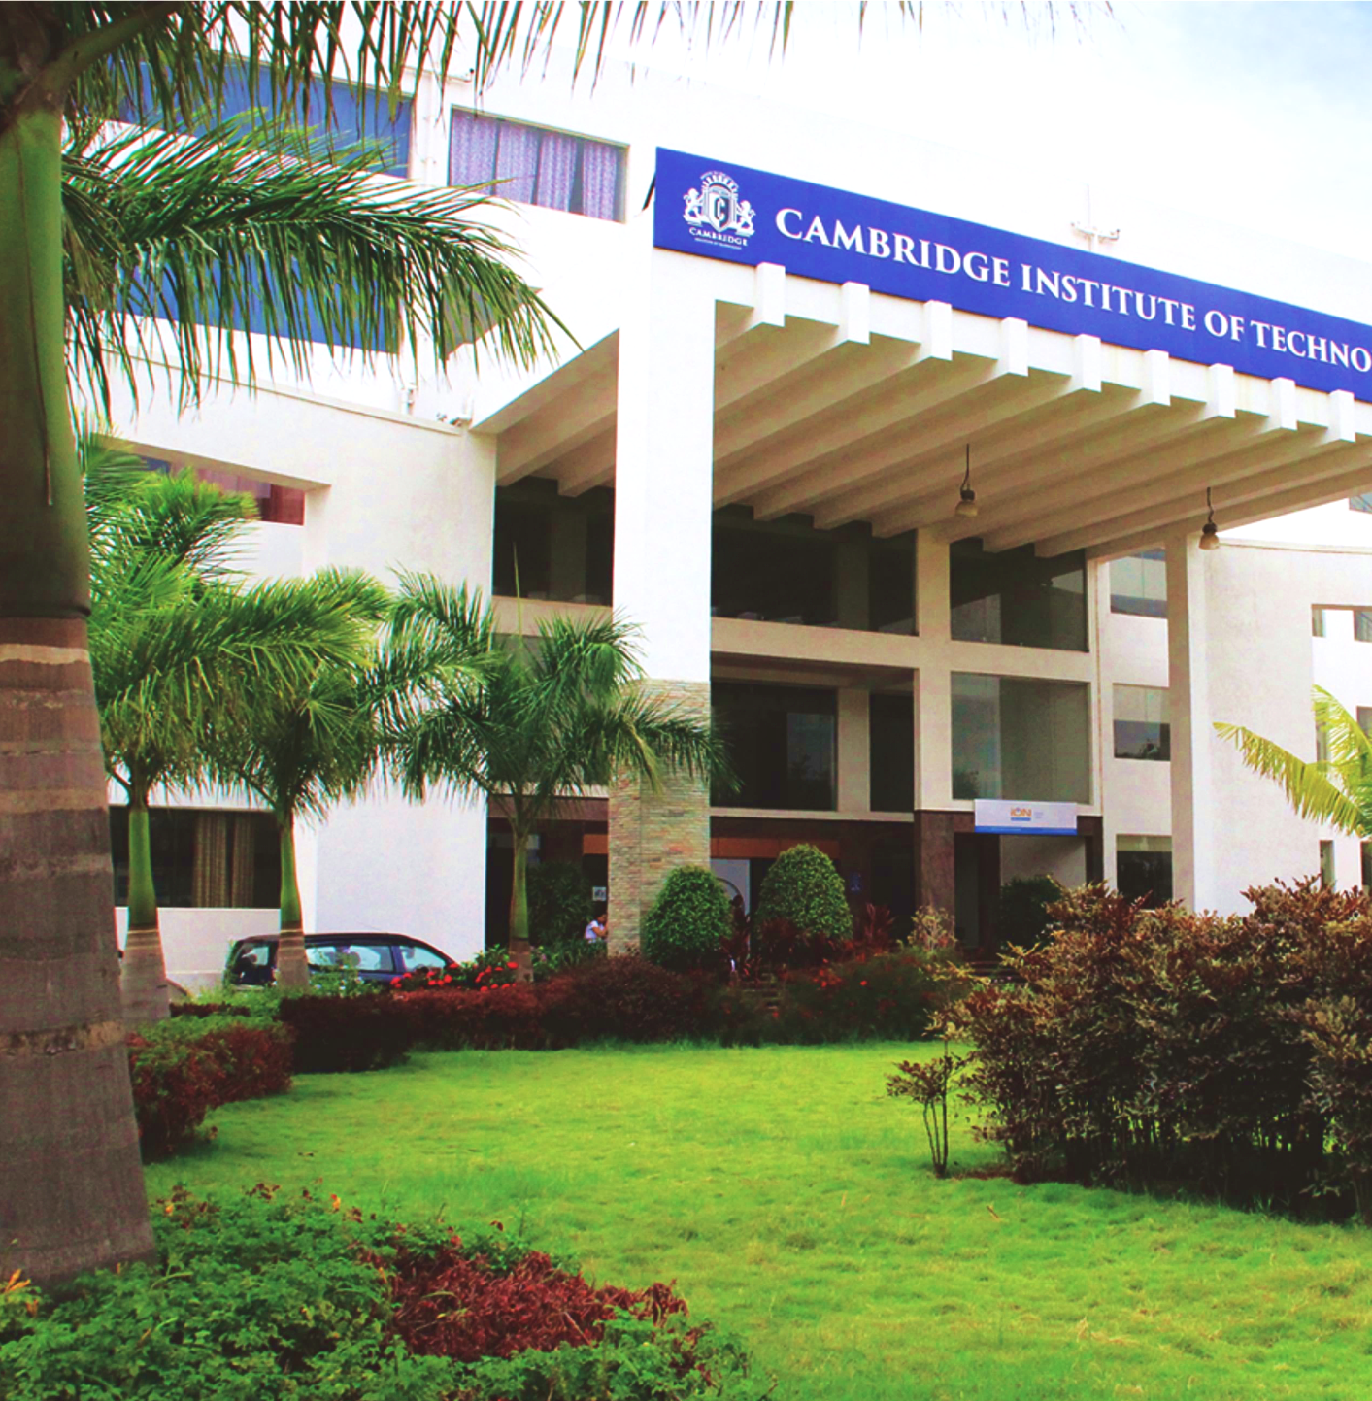
www.cambridge.edu.in
Project Work Phase – I
Subject Code:21AIMP67
Project Name:
An AI that learns how to walk
Presented By :
NEERAJ KUMAR 1CD21AI035
GAYATHRI DEVI B 1CD21AI016
Department of Artificial Intelligence and Machine Learning

Slide 2
Introduction
Welcome to our presentation on the fascinating journey of teaching an artificial intelligence (AI) agent to walk independently. This project dives into the realm of machine learning and robotics, demonstrating the capabilities and potential of AI in learning complex motor skills without human intervention. The quest to create machines that can learn and adapt to tasks autonomously has been a significant driving force in artificial intelligence (AI) research. Understanding how AI can learn to perform human-like tasks autonomously opens up numerous possibilities in various fields such as robotics, healthcare, and entertainment.
Department of Artificial Intelligence and Machine Learning www.Cambridge.edu.in

Slide 3
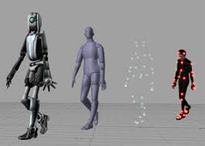
Among these tasks, enabling AI to learn to walk on its own represents a crucial milestone in the development of autonomous robots. Walking, a seemingly simple task for humans, involves complex coordination of sensory inputs and motor actions. This project explores the methodologies and technologies involved in training an AI to walk independently, aiming to contribute to advancements in robotics and AI learning algorithms. It showcases the advancements in AI and machine learning and their applications in solving real-world problems.
Department of Artificial Intelligence and Machine Learning www.Cambridge.edu.in

Slide 4
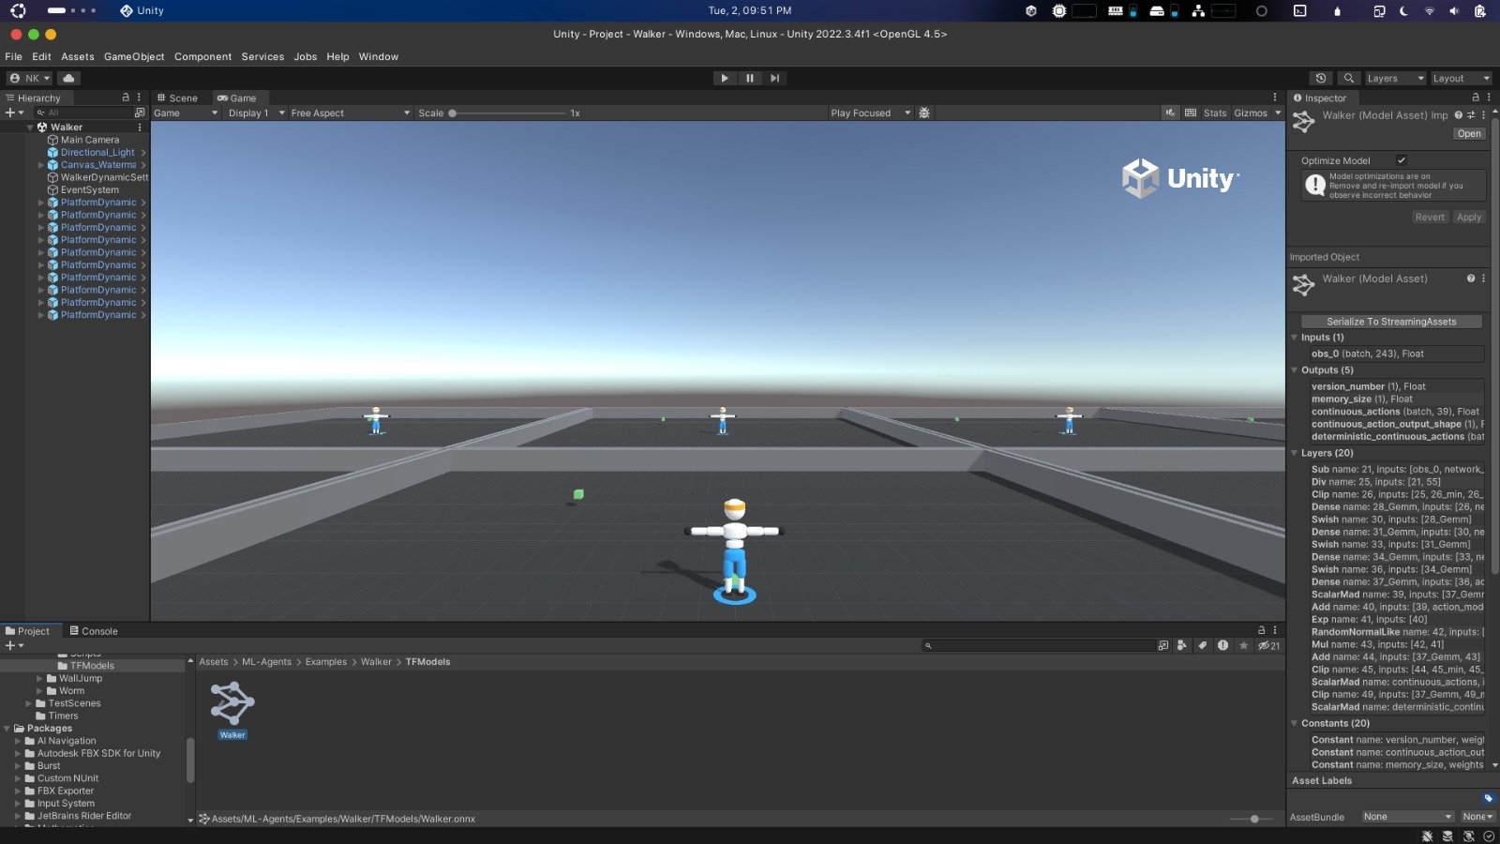
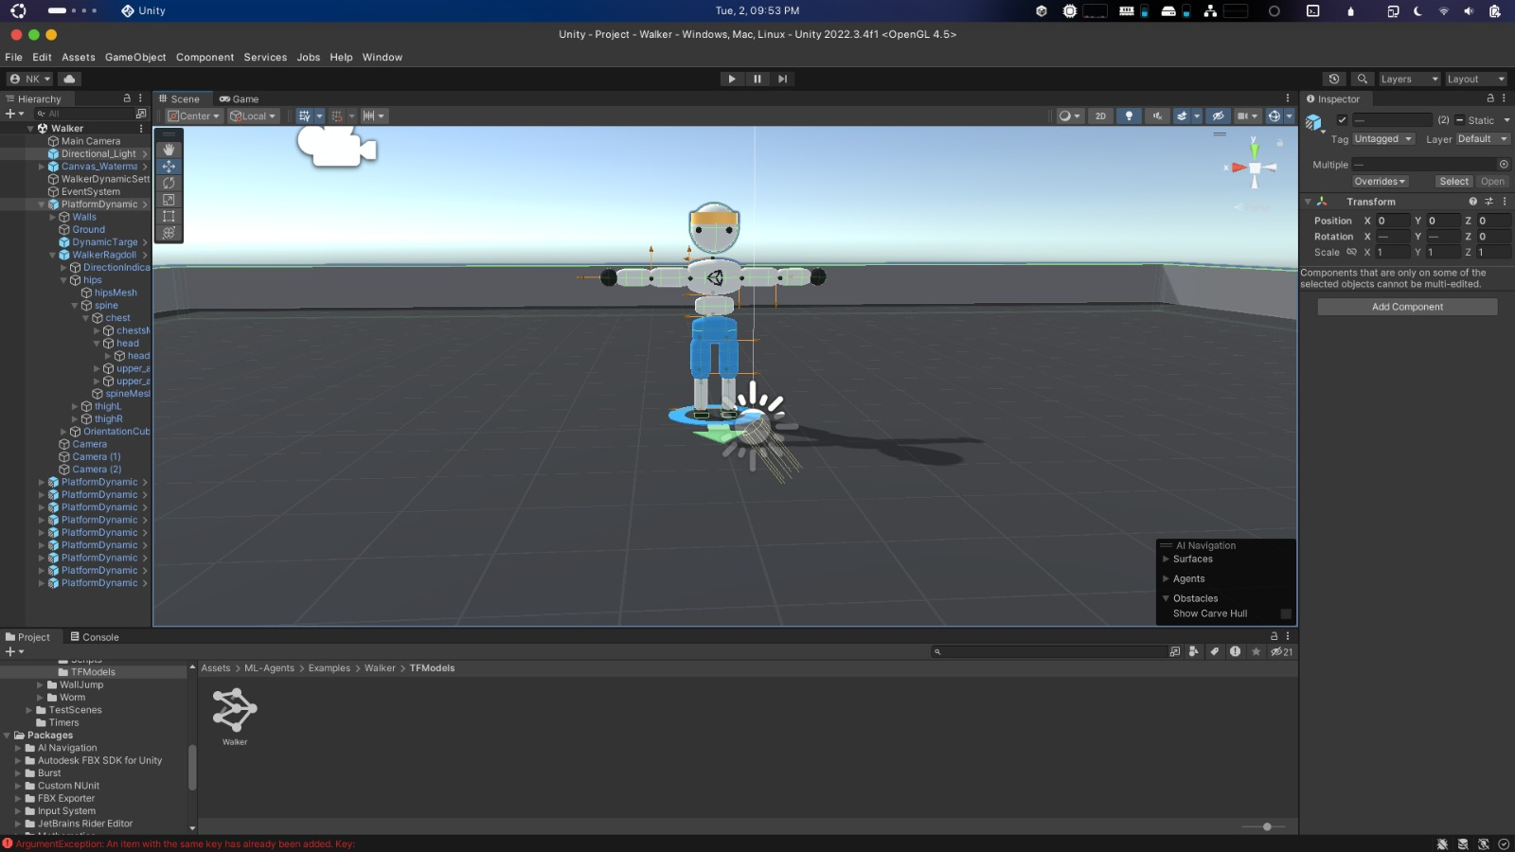
Department of Artificial Intelligence and Machine Learning www.Cambridge.edu.in

Slide 5
Problem Statement
" Creating an AI framework capable of learning complex motor skills in a manner similar to how living organisms do. "
Department of Artificial Intelligence and Machine Learning www.Cambridge.edu.in

Slide 6
Abstract
This study explores the development of an artificial intelligence (AI) system capable of learning to walk autonomously through reinforcement learning techniques. By simulating a virtual environment, the AI utilizes trial and error to optimize its locomotion strategy, improving balance, speed, and adaptability. The system's neural network continuously updates based on feedback from its actions, leading to progressively sophisticated and efficient walking patterns. This self-learning AI not only demonstrates potential for advancements in robotics and prosthetics but also offers insights into the underlying principles of human and animal locomotion, paving the way for future innovations in autonomous movement technologies.
Department of Artificial Intelligence and Machine Learning www.Cambridge.edu.in

Slide 7
Literature Survey
SL NO | PAPER TITLE | JOURNAL NAME | DESCRIPTION | PROS | CONS
1 | Reinforcement Learning: A Literature Review | IEEEXPLORE.IEEE.ORG | Reinforcement Learning (RL) trains agents to make decisions by maximizing rewards. This review traces RL's evolution, categorizing it into Flat, Hierarchical, and Meta RL. It highlights applications in fields like autonomous driving and healthcare, noting rapid progress driven by academia and industry giants. | Versatility Adaptive Learning Autonomy Innovative Research Complex Problem Solving | Computational Complexity Data Efficiency Stability and Convergence Generalization Implementation Challenges
2 | Reinforcement Learning: A Survey | IEEEXPLORE.IEEE.ORG | This survey by Kaelbling, Littman, and Moore explores reinforcement learning (RL) from a computer science perspective, addressing key concepts like exploration vs. exploitation, Markov decision processes, and learning from delayed rewards. It categorizes RL models, discusses various algorithms, and examines successful systems, highlighting future research directions. | Comprehensive Coverage Key Concepts Algorithm Discussion: Future Insights Interdisciplinary Links | Complexity Breadth Over Depth Dynamic Nature of Field Application Limitations Exploration Requirement

Slide 8
Literature Survey
SL NO | PAPER TITLE | JOURNAL NAME | DESCRIPTION | PROS | CONS
3 | Actuator and Sensor Fault Isolation | IEEEXPLORE.IEEE.ORG | This research paper presents a comprehensive method for isolating actuator and sensor faults in nonlinear dynamical systems, addressing modeling uncertainty, measurement noise, and multiple faults. It divides the isolation process into Sensor Fault Isolation (SFI) and Actuator Fault Isolation (AFI) modules, demonstrating effectiveness through simulations for improved system reliability and safety. | Comprehensive Approach Dual Modules Adaptive Techniques Handling Complexity Demonstrated Effectiveness | Complex Implementation Simulation Dependency Independent Modules Adaptive Thresholds Generalization Limits
4 | A finite time fuzzy adaptive output feedback fault | IEEEXPLORE.IEEE.ORG | This paper presents a finite-time fuzzy adaptive output-feedback fault-tolerant control (FTC) scheme for nonlinear underactuated wheeled mobile robots (UWMRs) with intermittent actuator faults. Utilizing fuzzy logic systems to approximate unknown dynamics and a backstepping control technique, the scheme ensures system stability and convergent estimation errors, validated by simulations. | Finite-Time Control Fuzzy Logic Systems Adaptive Output-Feedback Backstepping Control Validation | Complexity Simulation-Based Validation Specialized Application Intermittent Faults Tuning and Calibration

Slide 9
Literature Survey
SL NO | PAPER TITLE | JOURNAL NAME | DESCRIPTION | PROS | CONS
5 | A survey on multi agent reinforcement learning | IEEEXPLORE.IEEE.ORG | This research paper presents a comprehensive method for isolating actuator and sensor faults in nonlinear dynamical systems, addressing modeling uncertainty, measurement noise, and multiple faults. It divides the isolation process into Sensor Fault Isolation (SFI) and Actuator Fault Isolation (AFI) modules, demonstrating effectiveness through simulations for improved system reliability and safety. | Comprehensive Approach Dual Modules Adaptive Techniques Handling Complexity Demonstrated Effectiveness | Complex Implementation Simulation Dependency Independent Modules Adaptive Thresholds Generalization Limits
6 | A survey on multi agent reinforcement learning | IEEEXPLORE.IEEE.ORG | This paper surveys multi-agent reinforcement learning (MARL), covering its historical evolution, challenges, applications, and benchmark environments. It highlights the complexities of MARL, including communication and learning challenges, and the non-stationary environment. The paper also discusses MARL applications in robotics, telecommunications, and autonomous vehicles, providing a valuable resource for researchers and developers. | Comprehensive Coverage Highlighting Challenges Diverse Applications Benchmark Environments Valuable Resource | Complexity of Content Broad Focus Rapidly Evolving Field Simulation Limitations Interdisciplinary Knowledge Required

Slide 10
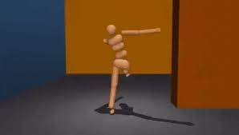
Objectives
The main objectives of this project are:
To develop a reinforcement learning model capable of learning and optimizing walking behavior.
To test the model's adaptability to different terrains and conditions.
To minimize the time and computational resources required for the AI to achieve stable walking.
To evaluate the performance of the AI in real-world simulations and identify areas for improvement.
Department of Artificial Intelligence and Machine Learning www.Cambridge.edu.in

Slide 11
System Requirements Analysis
Hardware Requirements :
CPU : a multi-core processor ( INTEL Core i5,i7,i9 or AMD Ryzen 4000 + series )
GPU : NVIDIA GPUs are commonly used for this purpose ( GEFORCE GTX and RTX series )
RAM : 16GB to 64GB RAM
Software Requirements :
Operating System : Windows 10 or Windows 11 or Ubuntu
Python : Python 3.11 or Above
Unity Hub : 22v+
Storage : SSD ( min 256GB – Recommended ) and HDD
Department of Artificial Intelligence and Machine Learning www.Cambridge.edu.in

Slide 12
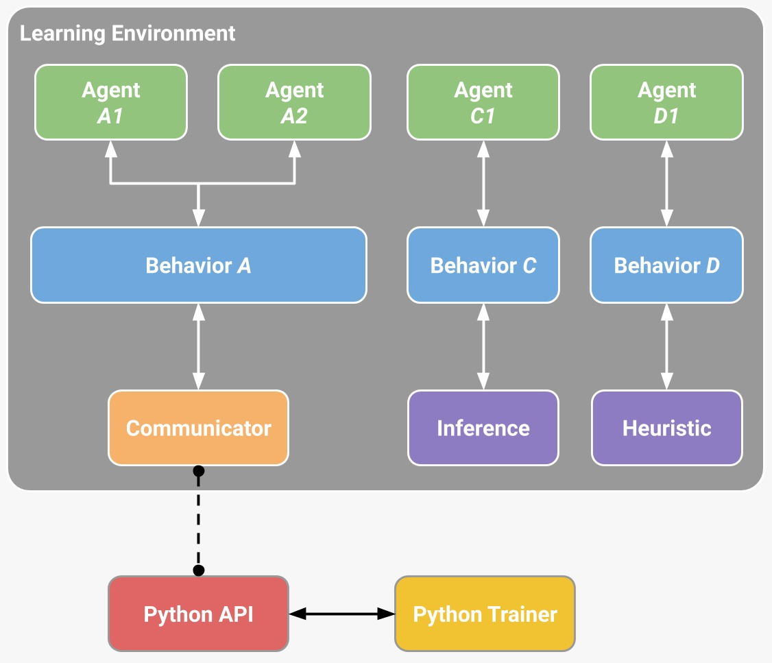
System Architecture & Design
Department of Artificial Intelligence and Machine Learning www.Cambridge.edu.in

Slide 13
Implementation & Methodology
The ML-agents toolkit contains five high-level components:
Learning environment –
Which contains the unity scene and all the game characters.
The unity scene provides the environment in which agents observe, act, and learn.
Depends on your goal. Trying to solve a reinforcement learning problem of limited scope,(for both training and for testing trained agents
In this case, it might be more efficient and practical to create a purpose-built training scene.
Includes an ml-agents unity sdk (com.Unity.ML-agents package)
That enables you to transform any unity scene into a learning environment by defining the agents and their behaviors.
Department of Artificial Intelligence and Machine Learning www.Cambridge.edu.in

Slide 14
Implementation
Python Low-Level API –
Which contains a low-level python interface for interacting and manipulating a learning environment.
Unlike the learning environment, the python API is not part of unity, but lives outside and communicates with unity through the communicator.
This API is contained in a dedicated mlagents_envs python package and is used by the python training process to communicate with and control the academy during training.
However, it can be used for other purposes as well.
For example, you could use the API to use unity as the simulation engine for your own machine learning algorithms.
Department of Artificial Intelligence and Machine Learning www.Cambridge.edu.in

Slide 15
Implementation
External communicator –
Which connects the learning environment with the python low-level API.
It lives within the learning environment.
Python trainers which contains all the machine learning algorithms that enable training agents.
The algorithms are implemented in python and are part of their own mlagents python package.
The package exposes a single command-line utility mlagents-learn that supports all the training methods and options outlined in this document.
The python trainers interface solely with the python low-level API.
Department of Artificial Intelligence and Machine Learning www.Cambridge.edu.in

Slide 16
Implementation
Gym Wrapper (not pictured)-
A common way in which machine learning researchers interact with simulation environments is via a wrapper provided by OpenAI called gym.
We provide a gym wrapper in the ml-agents-envs package and instructions for using it with existing machine learning algorithms which utilize gym.
PettingZoo Wrapper (not pictured)-
PettingZoo is python API for interacting with multi-agent simulation environments that provides a gym-like interface.
We provide a PettingZoo wrapper for Unity ML-Agents environments in the ml-agents-envs package and instructions for using it with machine learning algorithms.
Department of Artificial Intelligence and Machine Learning www.Cambridge.edu.in

Slide 17
Implementation
The Learning Environment contains two Unity Components that help organize the Unity scene:
Agents - which is attached to a Unity Game Object (any character within a scene) and handles generating its observations, performing the actions it receives and assigning a reward (positive / negative) when appropriate.
Each Agent is linked to a Behavior.
Behavior - defines specific attributes of the agent such as the number of actions that agent can take.
Each Behavior is uniquely identified by a Behavior Name field.
A Behavior can be thought as a function that receives observations and rewards from the Agent and returns actions.
Department of Artificial Intelligence and Machine Learning www.Cambridge.edu.in

Slide 18
Implementation
Behavior can be of one of three types: Learning, Heuristic or Inference.
A Learning Behavior is one that is not, yet, defined but about to be trained.
A Heuristic Behavior is one that is defined by a hard-coded set of rules implemented in code.
An Inference Behavior is one that includes a trained Neural Network file.
In essence, after a Learning Behavior is trained, it becomes an Inference Behavior.
Every Learning Environment will always have one Agent for every character in the scene.
While each Agent must be linked to a Behavior, it is possible for Agents that have similar observations and actions to have the same Behavior.
In our sample game, we have two teams each with their own medic.
Thus we will have two Agents in our Learning Environment, one for each medic, but both of these medics can have the same Behavior.
This does not mean that at each instance they will have identical observation and action values.
Department of Artificial Intelligence and Machine Learning www.Cambridge.edu.in

Slide 19
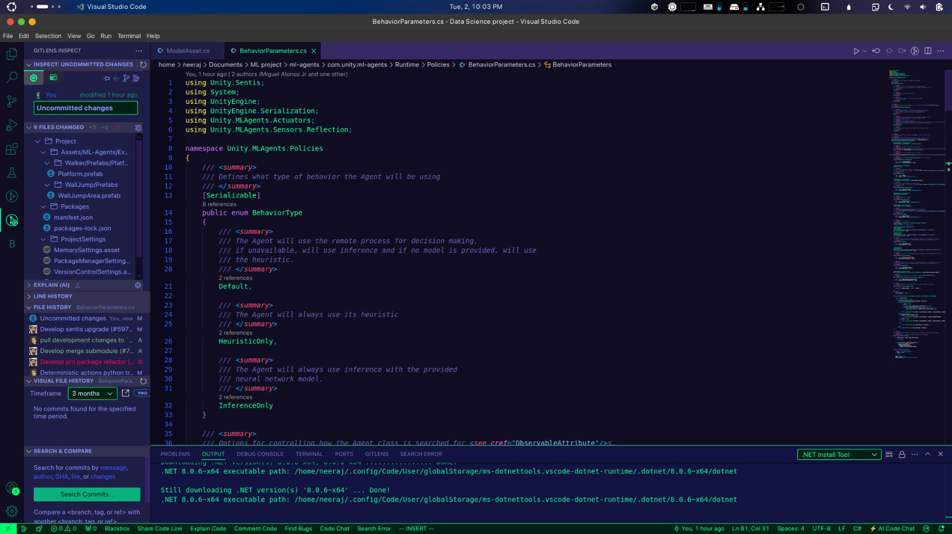
Code Snippets:
Department of Artificial Intelligence and Machine Learning www.Cambridge.edu.in

Slide 20
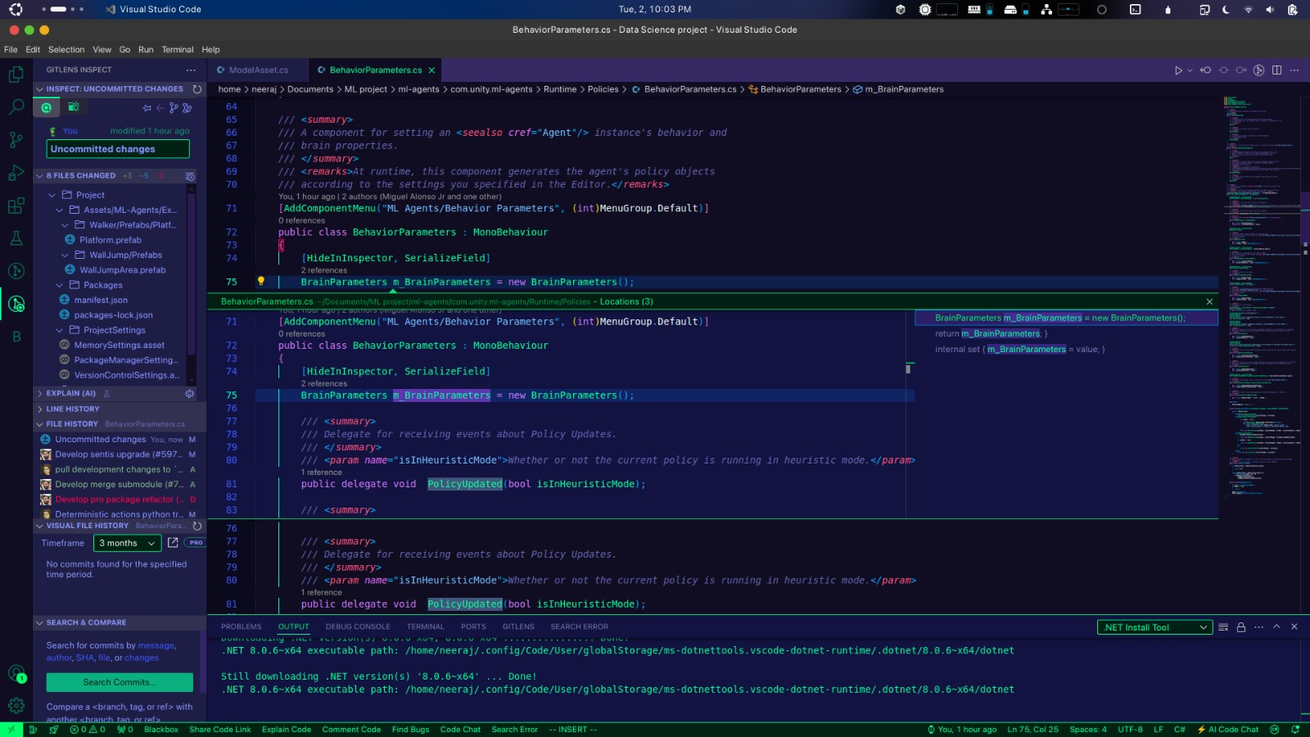
Code Snippets:
Department of Artificial Intelligence and Machine Learning www.Cambridge.edu.in

Slide 21
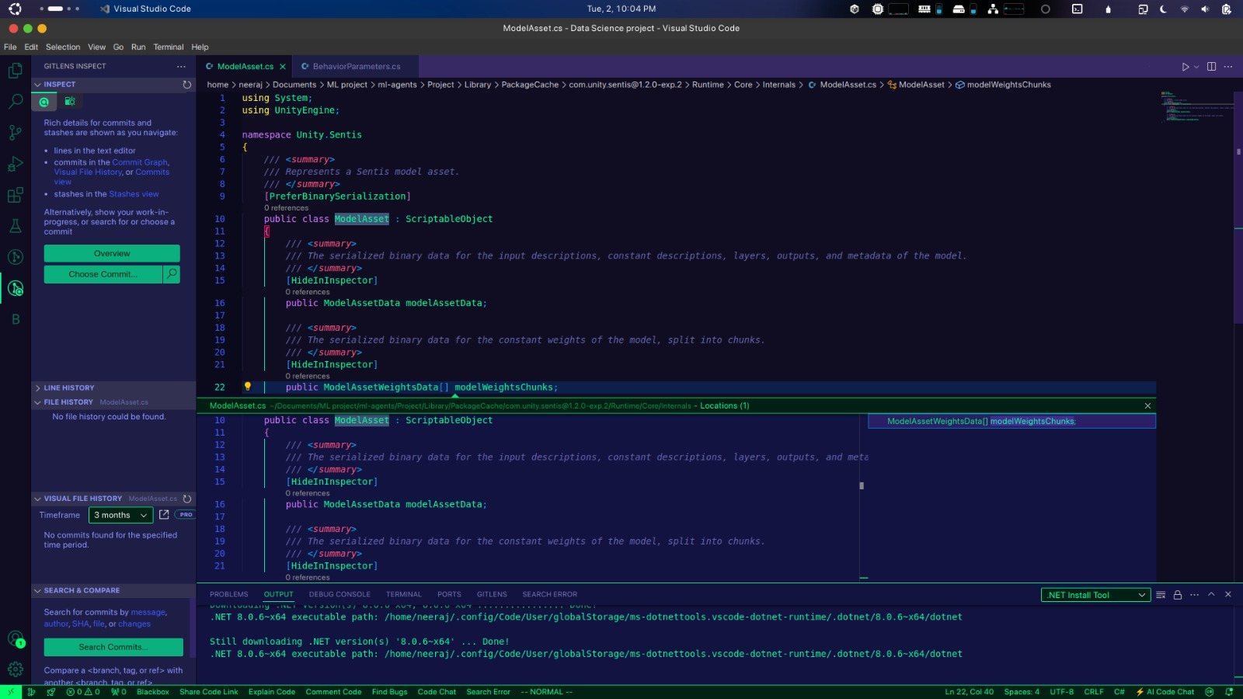
Code Snippets:
Department of Artificial Intelligence and Machine Learning www.Cambridge.edu.in

Slide 22
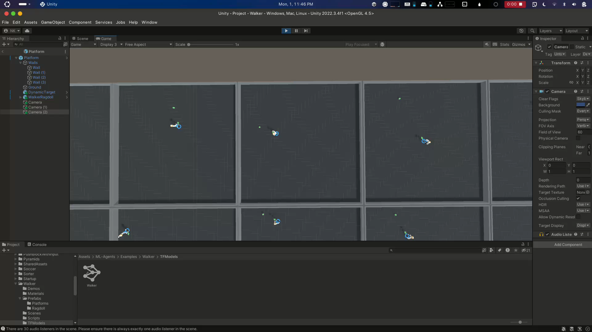
Results
Department of Artificial Intelligence and Machine Learning www.Cambridge.edu.in

Slide 23
Conclusion
This project demonstrates the feasibility and effectiveness of using reinforcement learning to teach an AI to walk autonomously. The results highlight the potential for further advancements in robotic locomotion and adaptive learning algorithms. However, challenges remain in transferring these capabilities from simulated environments to real-world applications, necessitating future research.
Department of Artificial Intelligence and Machine Learning www.Cambridge.edu.in

Slide 24
Future Enhancement
Real world Testing: Transferring the learned walking algorithms to physical robots and evaluating their performance in real-world conditions.
Enhanced Learning Algorithms: Exploring advanced RL algorithms and hybrid approaches to improve learning efficiency and robustness.
Multitask Learning: Training AI models to perform multiple locomotion tasks, such as running or climbing, to enhance their versatility.
Collaborative Robotics: Investigating how multiple AI agents can learn to walk and perform tasks collaboratively, mimicking social learning observed in nature.
Department of Artificial Intelligence and Machine Learning www.Cambridge.edu.in

Slide 25
References
[1]. Brahmbhatt, J. (2020). "This robot taught itself to walk entirely on its own." MIT Technology Review. Retrieved from [MIT Technology Review] (https://www.technologyreview.com/2020/03/02/905593/ai-robot-learns-to-walk-autonomously-reinforcement-learning/amp/).
[2]. Dillon, C. (2020). "AI teaches itself to walk using deep reinforcement learning." 80. lv. Retrieved from [80.lv] (https://80.lv/articles/ai-teaches-itself-to-walk-using-deep-reinforcement-learning/?amp=1).
[3]. Schulman, J., Wolski, F., Dhariwal, P., Radford, A., & Klimov, O. (2017). "Proximal Policy Optimization Algorithms." arXiv preprint arXiv:1707.06347.
[4]. Silver, D., Sutton, R. S., & Müller, M. (2008). "Reinforcement Learning: A Framework for Robotics." IEEE Robotics & Automation Magazine.
[5]. Mnih, V., Kavukcuoglu, K., Silver, D., et al. (2015)."Human-level control through deep reinforcement learning." Nature, 518(7540), 529-533.
Department of Artificial Intelligence and Machine Learning www.Cambridge.edu.in

Slide 26
THANK YOU
Department of Artificial Intelligence and Machine Learning www.Cambridge.edu.in

